Slide 1
Understanding Analytics

Slide 2
Analytics: What is it?
Analytics often involves studying past historical data to research potential trends, to analyze the effects of certain decisions or events, or to evaluate the performance of a given tool or scenario. The goal of analytics is to improve the business by gaining knowledge which can be used to make improvements or changes. It is the discovery and communication of meaningful patterns in data.

Slide 3
Reporting VS Analytics
Reporting | Analytics
The process of organizing data into informational summaries in order to monitor how different areas of a business are performing. | The process of exploring data and reports in order to extract meaningful insights, which can be used to better understand and improve business performance.
Reporting is the structuring of information in such a way that it can be used to measure and monitor business performance. It’s the process of converting data into information. | Business analytics solutions look a step further, helping you use business data to uncover opportunities in the market and to manage risk associated with business activities. It’s the process of converting information into knowledge

Slide 4
Reporting VS Analytics
1. Business Objective Reporting: Reporting solutions will help you measure performance of various business entities relative to business plan or target. It will help you convert data into information Analytics: Analytical solutions will help you identify new products, customer segments, reduce cost, risk & fraud. It will help you convert information into knowledge. Example: Reporting solution will tell you number of stock outs by items by store whereas Analytical solution will tell you about optimum amount of quantity that you need to keep in your store to minimize stock outs and opportunity cost. 2. Information output Reporting: Reporting solution output will help you quantify past performance. Analytics: Analytical solution output will help you infer unknown facts and relationships. It will also help you quantify future probabilities. Example: Reporting solution will tell you about best selling products in your portfolio whereas analytical solution will tell you about probability of buying a particular product when your customer visits your store next time.

Slide 5
Reporting VS Analytics
3. Output Reporting: Historical standard reports, cubes for OLAP.
Analytics: Predictive models, scores, forecasts. Example Reporting: Top 10 products by revenue, Top 10 customers by region Analytics: Cross Sell/Up Sell Model, Forecasting by Product by Region by Time 4. Queries Reporting: Known, simple queries which can be easily optimized. Analytics: Queries that become very complex as they evolve via iteration.
Reporting solution will help you answer the following questions What happened? When did it happen?
Analytical solution will help you answer the following questions
Why is it happening? What opportunities am I missing?

Slide 6
Advanced Analytics
Advanced Analytics is a grouping of analytic techniques used to predict future outcomes. Advanced analytics can include:
Predictive analytics
What will happen next if our customers continue to purchase as they have in the past?
What is likely to happen to our sales if the current trends continue?
Simulation
What if we introduce a new product into the market, how are our competitors likely to react?
What if we change our pricing strategy, how will that impact our customer loyalty and market penetration?
Optimization
How can we achieve the best loading plan for a truck?
What are the best drug research projects to invest in to maximize our profits, minimize our cash outflow in the next 24 months and coincide with our expiring drug patents?

Slide 7
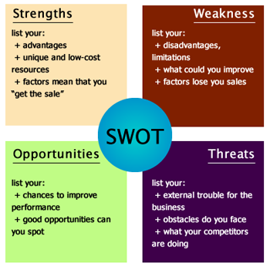
Conducting an Analysis: SWOT Analysis

Slide 8
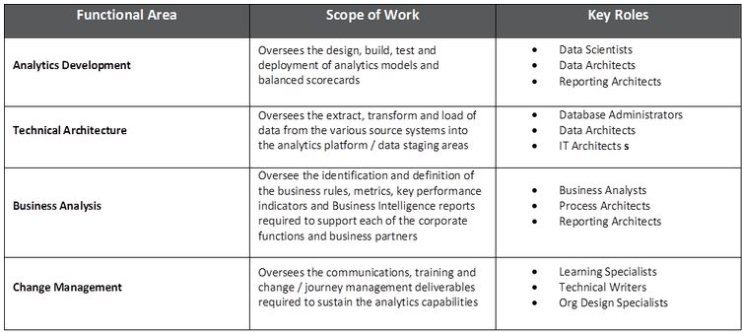
Building Analytics Team

Slide 9
Analytic Tools
Google Analytics (google.com/analytics) – Free, A completely free service that generates detailed statistics about visitors to your website, Google Analytics is the simplest and most robust web analytics offering.
Yahoo Web Analytics (web.analytics.yahoo.com) – Free, Once you've mastered Google Analytics, Yahoo's similar offering gives you a little more depth in your surveying

Slide 10
Other Analytics Tools
R
SPSS
SAS

Slide 11
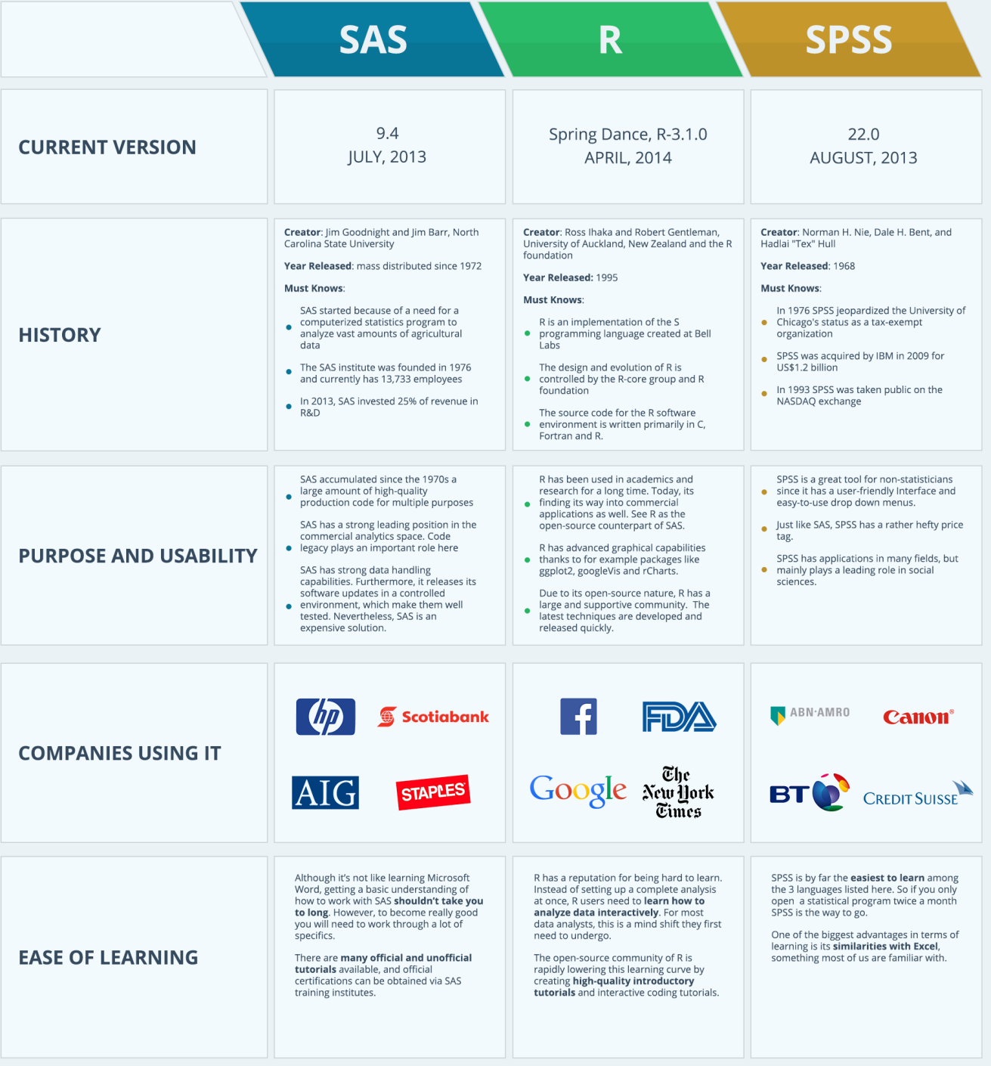
Comparisons

Slide 12
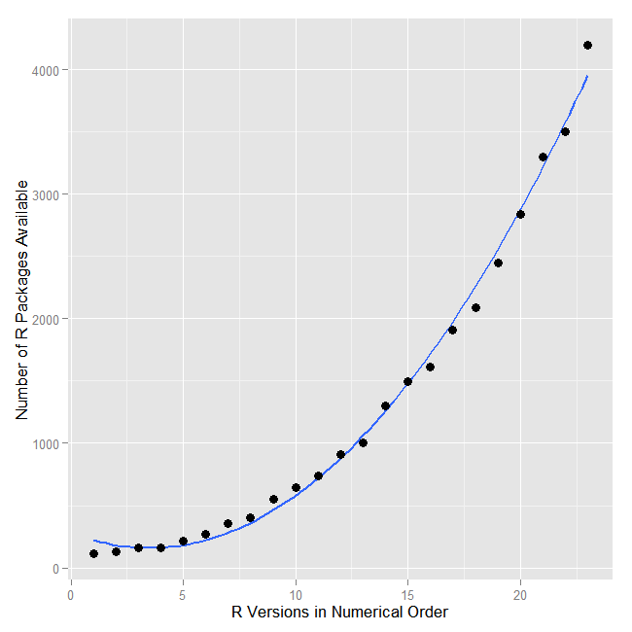
Why R wins the race?

Slide 13
References
http://iianalytics.com/research/building-an-analytics-team-for-your-organization-a-view-into-the-operating
http://blogs.adobe.com/digitalmarketing/analytics/reporting-vs-analysis-whats-the-difference/
http://mybusinessanalytics.blogspot.in/2011/03/reporting-vs-analytics.html
http://searchbusinessanalytics.techtarget.com/definition/advanced-analytics

